Slide 1




Employee Exit Survey
EDA using Python
Present By :- K Rama Krishna

Slide 2



Project Description
In this Project we'll work with exit surveys from employees of the Department of Education, Training and Employment (DETE) and the Technical and Further Education (TAFE) institute in Queensland, Australia and we analyze the data clean Employee Exit Date using Python and SQL and perform some EDA operations.

Slide 3
Data
What is Data?
Data is a collection of information that is gathered through observations, measurements, research, or analysis.
Types of Data:
Numerical data: Quantitative data that can be represented by numbers. For example, height.
Categorical data: Qualitative data that can be represented by labels or names. For example, gender.

Slide 4



context
Data Collecting
Data Cleaning
Data Visualization

Slide 5


Data Collecting
I am collecting the data from the website of the Department of Education, Training and Employment (DETE) using Excel.
In Excel there is an option called is data.
In Data option it shows no of options Like PDF,CSV Etc. But I used From the web option it is easy way to extract the data from the web site.
After extract the data from the web site then. I am save has the CSV format and then started the analyze the data using python and SQL

Slide 6

Data Cleaning
In data cleaning. I used no of liberates to clean the data.
For Loading Purpose used the pd.read_csv().This function is used to read the data set from the given location and it read only CSV files.
For Knowing the each column data types df.info().Here df means Data Frame and info() function is used to know all the data types in whole data set.
For Removing all unnecessary columns from given data using df.drop(axis=1,inplace=True) and drop means to remove specify columns from the given data set and inplace=True means to delete permanently from the data set.
For Knowing duplicated values df.duplicated().To knowing duplicate values from the give data set using this function called duplicated.
For Knowing Null values df.isna(). Checking null values from the given data set called isna means is null values
For removing null values from the given data set using this function called df.dropna() .
From removing duplicated values from the given data set using function called df.drop_duplicate().
To know the no of the values are present in each columns is df.value_counts().

Slide 7


Data Visualization
In Data Visualization. I used Visualization tools like Matplotlib, Seaborn

Slide 8
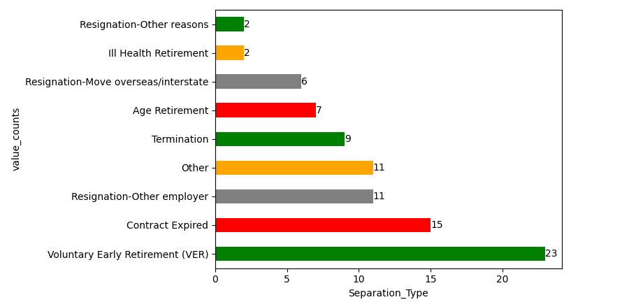
Data Visualization of the column is Separation_Type and the value of the counts
c=['green','red','Grey','orange']
ax=Es['Separation_Type'].value_counts().plot(kind=‘barh',color=c)
for i in ax.containers:
plt.bar_label(i,)
plt.xlabel("Separation_Type")
plt.ylabel("value_counts")
plt.show()

Slide 9
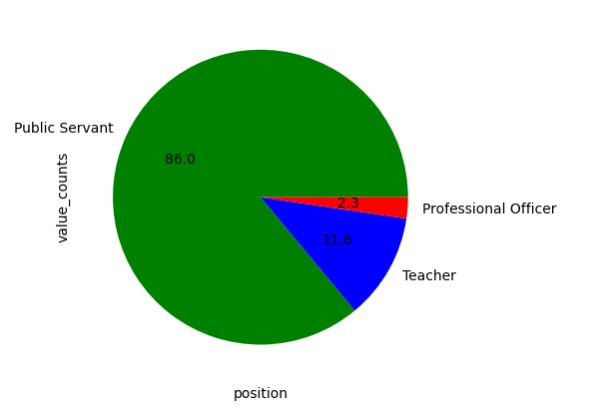
Data Visualization of the column is Position and the value of the counts
colors = ['green', 'blue', 'red']
Es['Position'].value_counts().plot(kind='pie',autopct='%1.1f',colors=colors)
plt.xlabel('position')
plt.ylabel("value_counts")
plt.show()

Slide 10
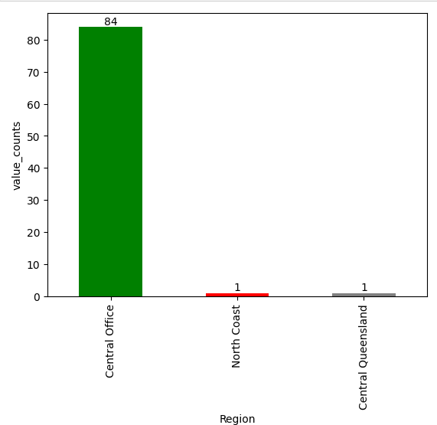
Data Visualization of the column is Region and the value of the counts
col=['green','red','blue']
ax=Es['Region'].value_counts().plot(kind='bar',color=c)
for i in ax.containers:
plt.bar_label(i,)
pass
plt.xlabel("Region")
plt.ylabel("value_counts")
plt.show()

Slide 11
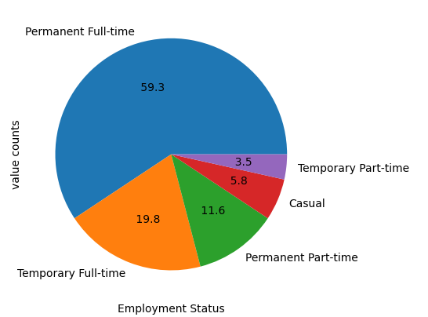
Data Visualization of the column is Employee status and the value of the counts
Es['Employment Status'].value_counts().plot(kind='pie',autopct='%5.1f')
plt.xlabel("Employment Status")
plt.ylabel("value counts")
plt.show()

Slide 12
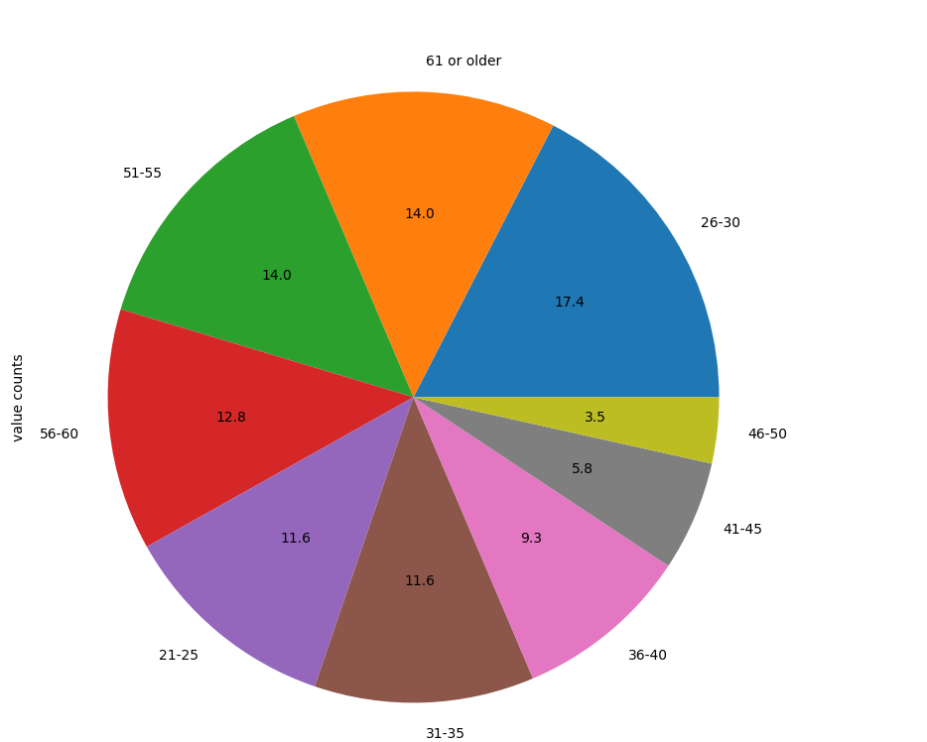
Data Visualization of the column is Age and the value of the counts
plt.figure(figsize=(10,10))
Es['Age'].value_counts().plot(kind='pie',autopct="%1.1f")
plt.xlabel("Age")
plt.ylabel("value counts")
plt.show()

Slide 13
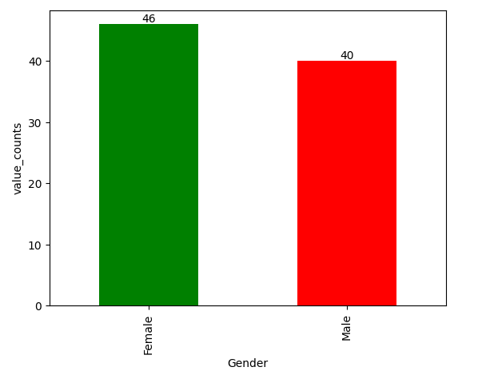
Data Visualization of the column is Gender and the value of the counts
c=['green','red']
ax=Es['Gender'].value_counts().plot(kind='bar',color=c)
for i in ax.containers:
plt.bar_label(i,)
pass
plt.xlabel('Gender')
plt.ylabel('value_counts')
plt.show()

Slide 14


